Slide 1
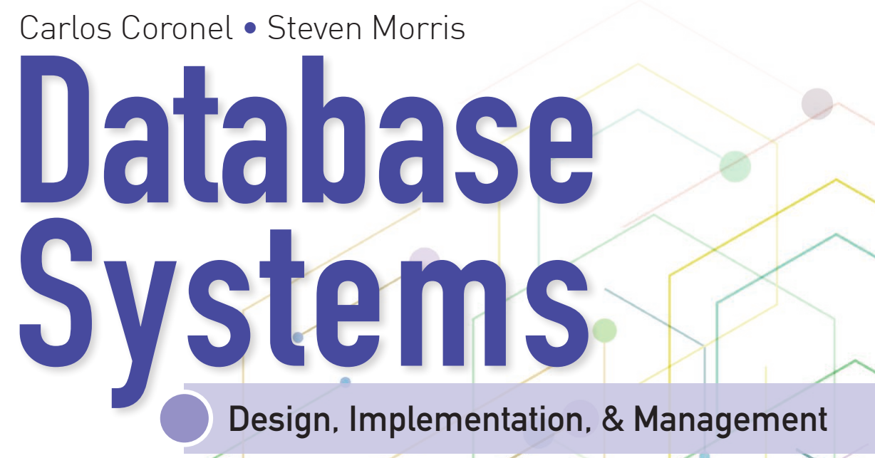
Database Systems:
Design, Implementation, and Management
14th Edition
Chapter 1
Database Systems
Database System Design, Implementation And Management

Slide 2
National Economics University
Faculty of Mathematical Economics
Database System Design, Implementation And Management Course
Instructor: Duc Minh Vu (MFE)
Email: minhvd [at] neu.edu.vn

Slide 3
Learning Objectives
Define the difference between data and information
Describe what a database is, the various types of databases, and why they are valuable assets for decision making
Explain the importance of database design
Outline how modern databases evolved from file systems
Identify flaws in file system data management
Outline the main components of the database system
Describe the main functions of a database management system (DBMS)
Database System Design, Implementation And Management

Slide 4
Introduction
Good decisions require good information derived from raw facts
Data is managed most efficiently when stored in a database
Databases evolved from computer file systems
Understanding file system characteristics is important
Database System Design, Implementation And Management

Slide 5
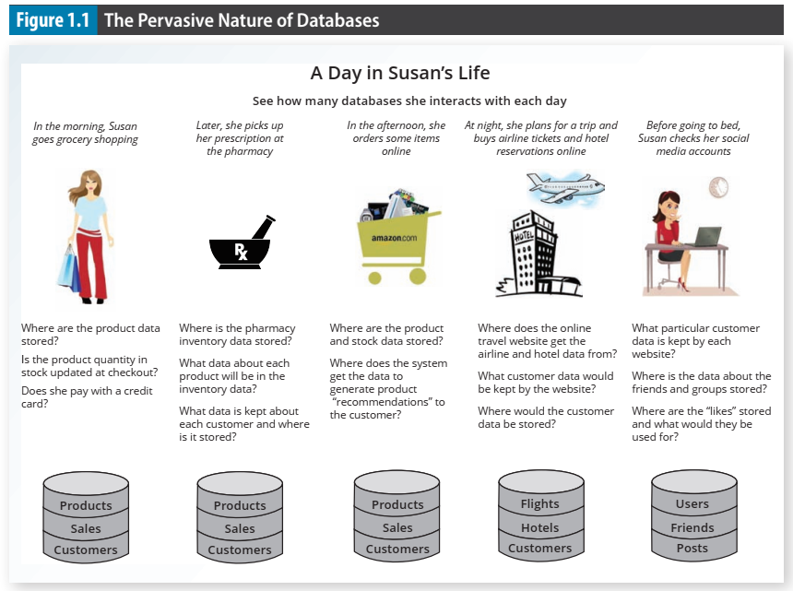
Database System Design, Implementation And Management

Slide 6
1-1. Why Databases?
Data is ubiquitous (abundant, global, everywhere) and pervasive (unescapable, prevalent, persistent).
  From birth to death, we generate and consume data.
Data is also essential for organizations to survive and prosper.
Business information systems is to help businesses use information as an organizational resource.
  At the heart of all of these systems are the collection, storage, aggregation, manipulation, dissemination, and management of data.
Databases are specialized structures that allow computer-based systems to store, manage, and retrieve data very quickly.
Database System Design, Implementation And Management

Slide 7
1-2 Data versus Information
Data are raw facts
Information is the result of processing raw data to reveal meaning
Information requires context to reveal meaning
Raw data must be formatted for storage, processing, and presentation
Data are the foundation of information, which is the bedrock of knowledge
Database System Design, Implementation And Management

Slide 8
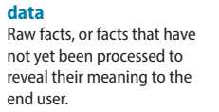
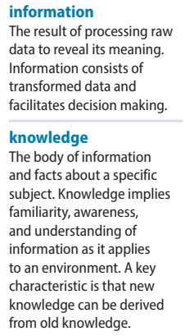
1-2 Data versus Information (cont’d.)
Data: building blocks of information
Information produced by processing data
Information used to reveal meaning in data
Accurate, relevant, timely information is the key to good decision making
Good decision making is the key to organizational survival
Data management: focuses on proper generation, storage, and retrieval of data
Database System Design, Implementation And Management

Slide 9
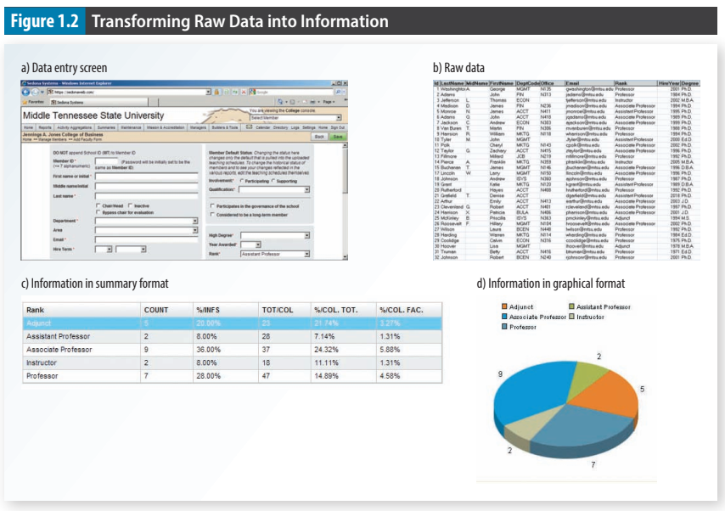
Database System Design, Implementation And Management

Slide 10
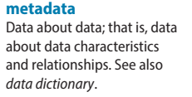
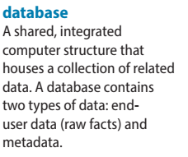
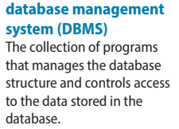
1-3 Introducing the Database
Database: shared, integrated computer structure that stores a collection of:
  End-user data: raw facts of interest to end user
  Metadata: data about data
    Provides description of data characteristics and relationships in data
    Complements and expands value of data
Database management system (DBMS): collection of programs that manages the database structure and controls access to the data stored in the database
Database System Design, Implementation And Management

Slide 11
1-3a Role and Advantages of the DBMS
DBMS is the intermediary between the user and the database
  Database structure stored as file collection
  Can only access files through the DBMS
DBMS enables data to be shared
DBMS integrates many users’ views of the data
Database System Design, Implementation And Management

Slide 12
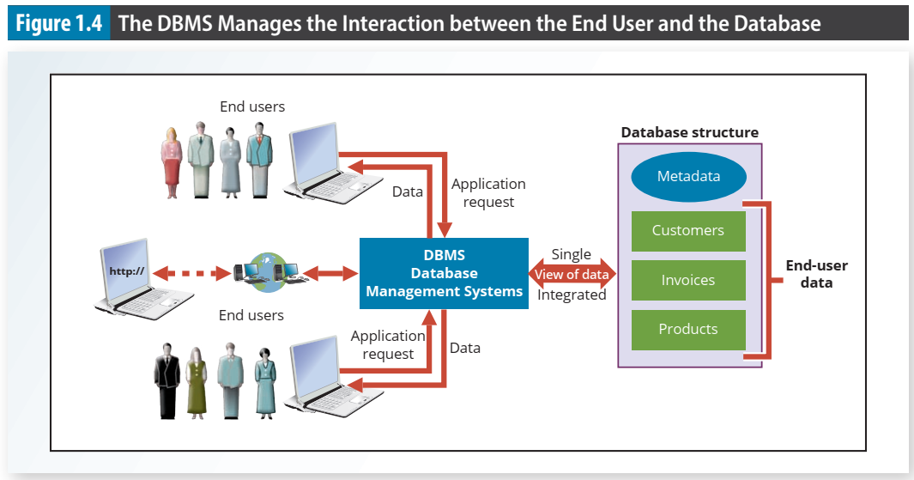
Database System Design, Implementation And Management

Slide 13
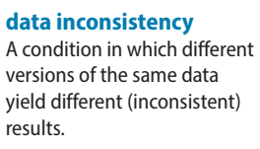
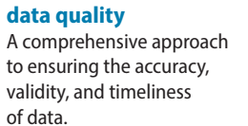
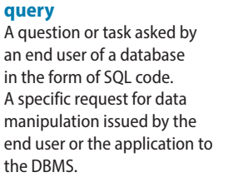
Role and Advantages of the DBMS (cont’d.)
Advantages of a DBMS:
  Improved data sharing
  Improved data security
  Better data integration
  Minimized data inconsistency
  Improved data access
  Improved decision making
  Increased end-user productivity
Database System Design, Implementation And Management

Slide 14
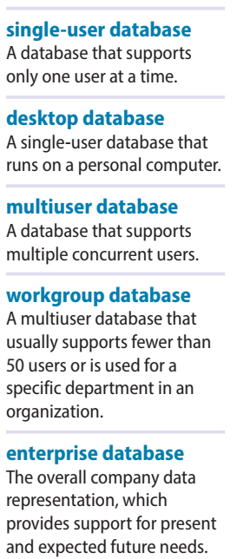
Types of Databases
Databases can be classified according to:
  Number of users
  Database location(s)
  Expected type and extent of use
Single-user database supports only one user at a time
  Desktop database: single-user; runs on PC
Multiuser database supports multiple users at the same time
  Workgroup and enterprise databases
Database System Design, Implementation And Management

Slide 15
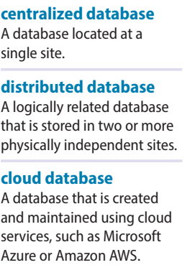
Types of Databases (cont’d.)
Centralized database: data located at a single site
Distributed database: data distributed across several different sites
Cloud database: is a database that is created and maintained using cloud data services, such as Microsoft Azure or Amazon AWS
Database System Design, Implementation And Management

Slide 16
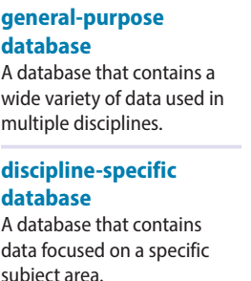
Types of Databases (cont'd.)
General-purpose database: contain a wide variety of data used in multiple disciplines—for example, a census database that contains general demographic data and the LexisNexis and ProQuest databases that contain newspaper, magazine, and journal articles for a variety of topics.
Discipline-specific databases: contain data focused on specific subject areas
Database System Design, Implementation And Management

Slide 17
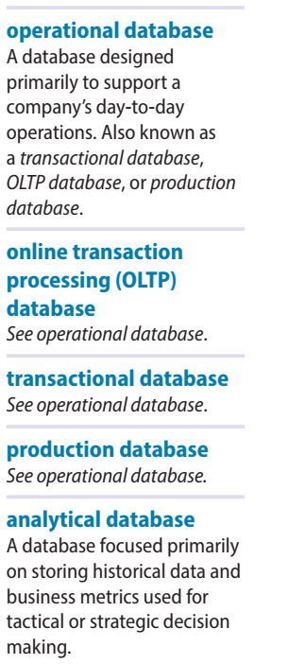
Types of Databases (cont'd.)
operational database - online transaction processing (OLTP) database – transactional database - or production database: a database that is designed primarily to support a company’s day-to-day operations.
Analytical database focuses primarily on storing historical data and business metrics used exclusively for tactical or strategic decision making.
Database System Design, Implementation And Management

Slide 18
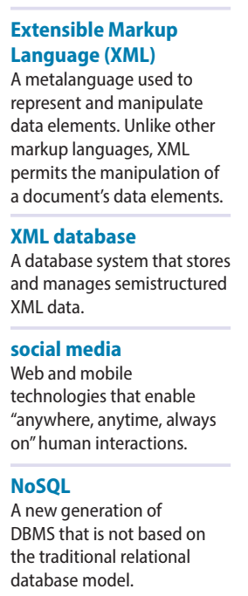
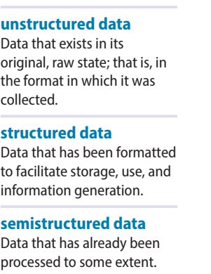
Types of Databases (cont'd.)
Unstructured data exist in their original state
Structured data result from formatting
  Structure applied based on type of processing to be performed
Semi-structured data have been processed to some extent
Extensible Markup Language (XML) represents data elements in textual format
  XML database supports semi-structured XML data
Database System Design, Implementation And Management

Slide 19
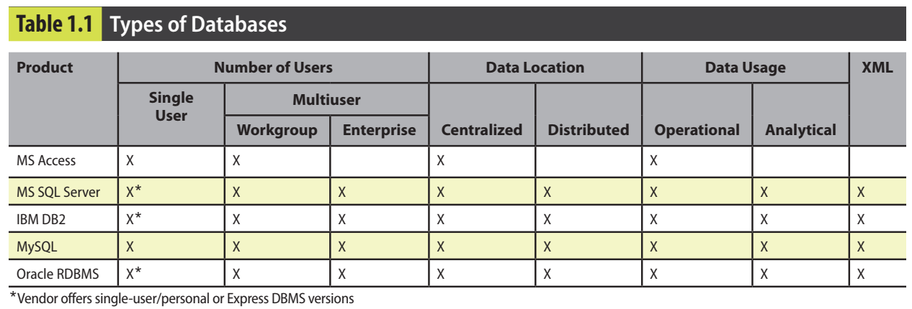
Database System Design, Implementation And Management

Slide 20
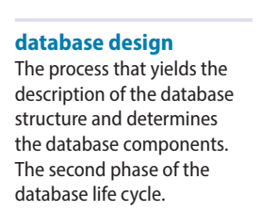
1-4 Why Database Design Is Important
Database design focuses on design of database structure used for end-user data
  Designer must identify database’s expected use
Well-designed database:
  Facilitates data management
  Generates accurate and valuable information
Poorly designed database:
  Causes difficult-to-trace errors
Database System Design, Implementation And Management

Slide 21
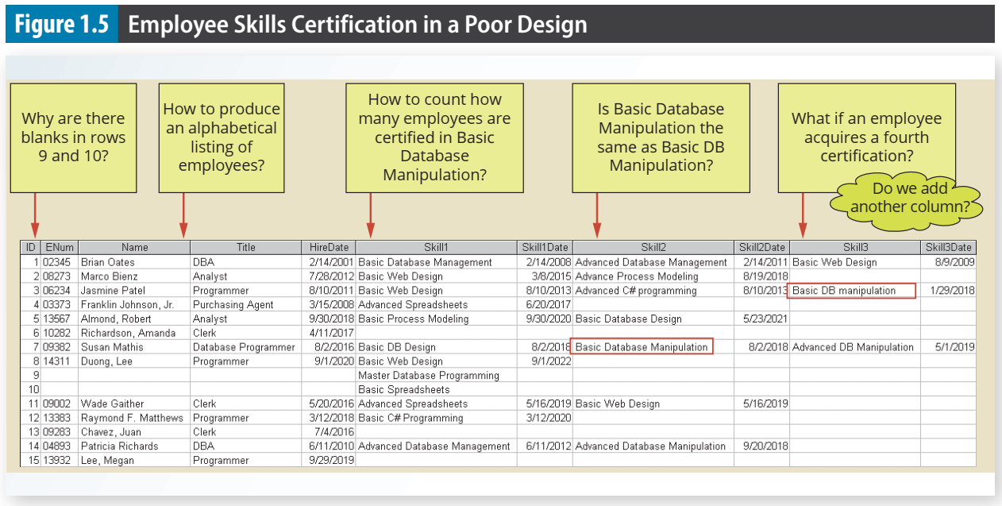
Database System Design, Implementation And Management

Slide 22

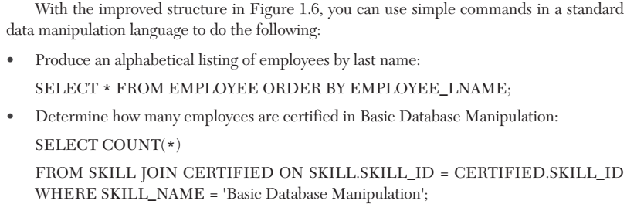
Database System Design, Implementation And Management

Slide 23
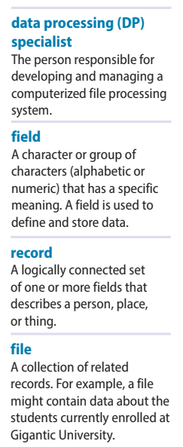
1-5 Evolution of File System Data Processing
Reasons for studying file systems:
  Complexity of database design is easier to understand
  Understanding file system problems helps to avoid problems with DBMS systems
  Knowledge of file system is useful for converting file system to database system
File systems typically composed of collection of file folders, each tagged and kept in cabinet
  Organized by expected use
Database System Design, Implementation And Management

Slide 24
1-5 Evolution of File System Data Processing (cont'd.)
Contents of each file folder are logically related
Manual file systems
  Served as a data repository for small data collections
  Cumbersome for large collections
Computerized file systems
  Data processing (DP) specialist converted computer file structure from manual system
    Wrote software that managed the data
    Designed the application programs
Database System Design, Implementation And Management

Slide 25
1-5 Evolution of File System Data Processing (cont'd.)
Initially, computer file systems resembled manual systems
As number of files increased, file systems evolved
  Each file used its own application program to store, retrieve, and modify data
  Each file was owned by individual or department that commissioned its creation
Database System Design, Implementation And Management

Slide 26
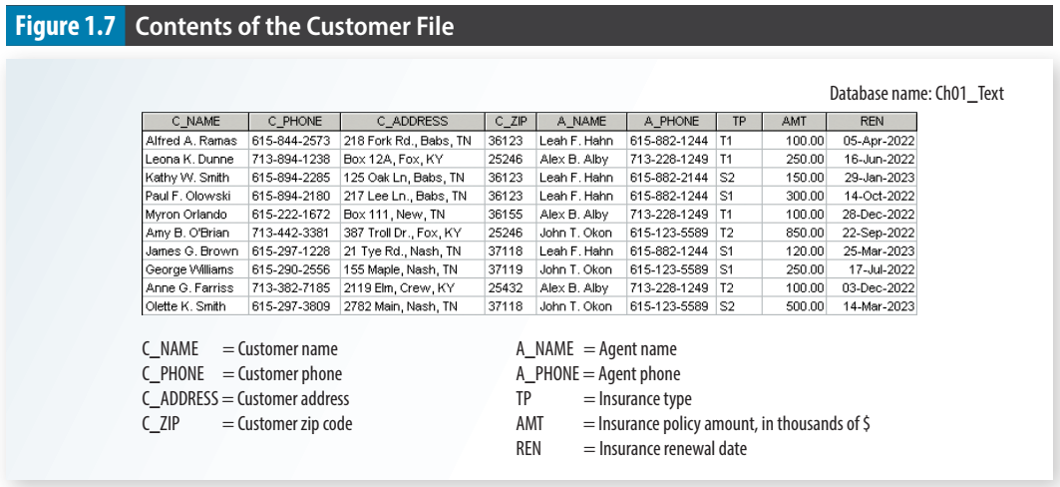
Database System Design, Implementation And Management

Slide 27
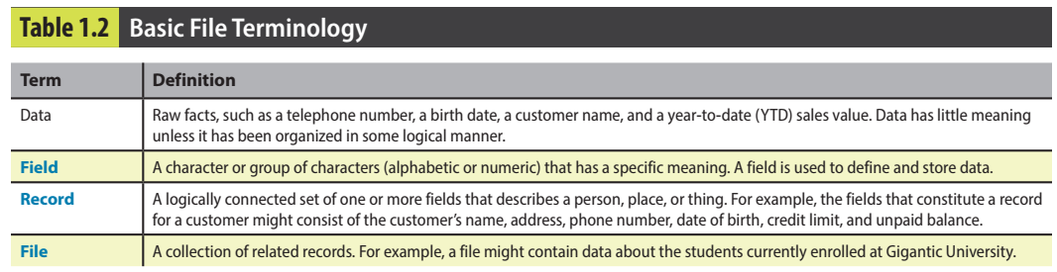
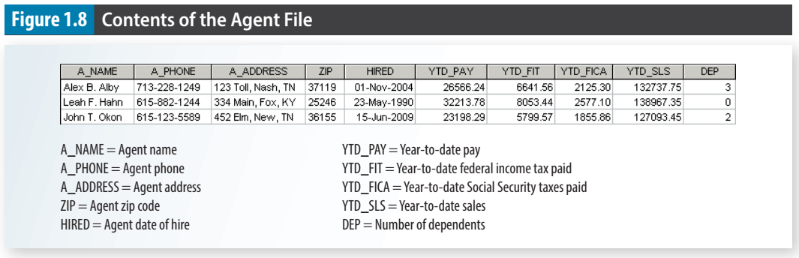
Database System Design, Implementation And Management

Slide 28
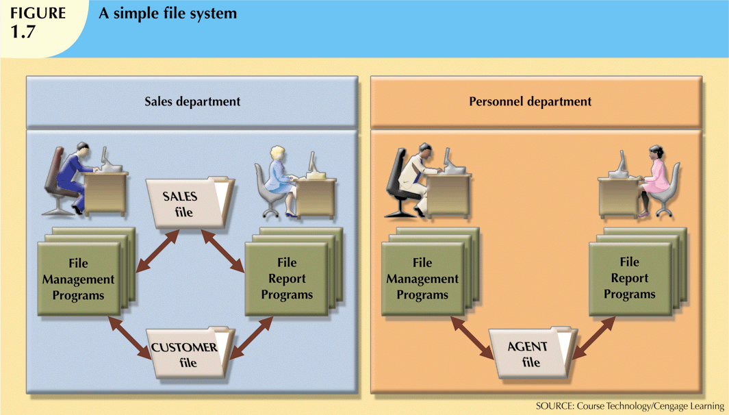
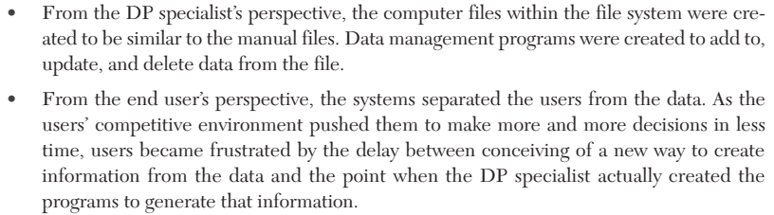
Database System Design, Implementation And Management

Slide 29
File System Redux: Modern End-User Productivity Tools
Ubiquitous use of personal productivity tools can introduce the same problems as the old file systems
Microsoft Excel
  Widely used by business users
  Users have become so adept at working with spreadsheets, they tend to use them to complete tasks for which spreadsheets are not appropriate – database substitute
Database System Design, Implementation And Management

Slide 30
1-6 Problems with File System Data Processing
File systems were an improvement over manual system
  File systems used for more than two decades
  Understanding the shortcomings of file systems aids in development of modern databases
  Many problems not unique to file systems
Even simple file system retrieval task required extensive programming
  Ad hoc queries impossible
  Changing existing structure difficult
Database System Design, Implementation And Management

Slide 31
1-6 Problems with File System Data Processing (cont'd.)
Security features difficult to program
  Often omitted in file system environments
Summary of file system limitations:
  Requires extensive programming
  Cannot perform ad hoc queries
  System administration is complex and difficult
  Difficult to make changes to existing structures
  Security features are likely to be inadequate
Database System Design, Implementation And Management

Slide 32
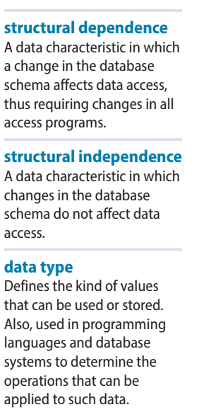
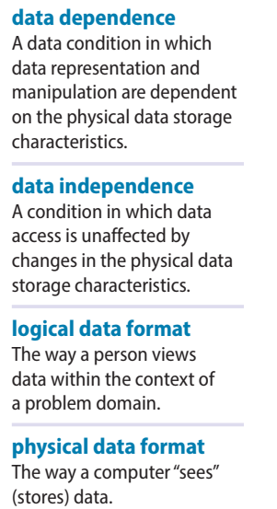
1-6a Structural and Data Dependence
Structural dependence: access to a file is dependent on its own structure
  All file system programs must be modified to conform to a new file structure
Structural independence: change file structure without affecting data access
Data dependence: data access changes when data storage characteristics change
Data independence: data storage characteristics do not affect data access
Database System Design, Implementation And Management

Slide 33
1-6a Structural and Data Dependence (cont'd.)
Practical significance of data dependence is difference between logical and physical format
Logical data format: how human views the data
Physical data format: how computer must work with data
Each program must contain:
  Lines specifying opening of specific file type
  Record specification
  Field definitions
Database System Design, Implementation And Management

Slide 34
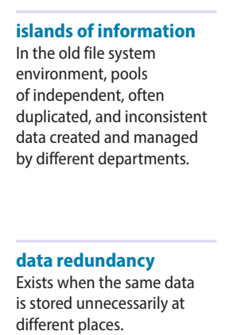
1-6b Data Redundancy
File system structure makes it difficult to combine data from multiple sources
  Vulnerable to security breaches
Organizational structure promotes storage of same data in different locations
  Islands of information
Data stored in different locations is unlikely to be updated consistently
Data redundancy: same data stored unnecessarily in different places
Database System Design, Implementation And Management

Slide 35
1-6b Data Redundancy (cont'd.)
Data inconsistency: different and conflicting versions of same data occur at different places
Poor data security
Data inconsistency
Data-entry errors
Data integrity problems
Database System Design, Implementation And Management

Slide 36
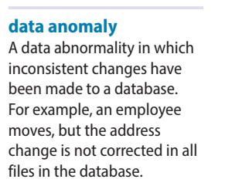
1-6c Data Anomalies
Data anomalies: abnormalities when all changes in redundant data are not made correctly
  Update anomalies
  Insertion anomalies
  Deletion anomalies
Database System Design, Implementation And Management

Slide 37
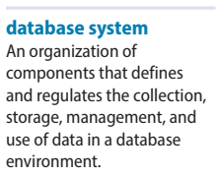
1-7 Database Systems
Database system consists of logically related data stored in a single logical data repository
  May be physically distributed among multiple storage facilities
  DBMS eliminates most of file system’s problems
  Current generation stores data structures, relationships between structures, and access paths
    Also defines, stores, and manages all access paths and components
Database System Design, Implementation And Management

Slide 38
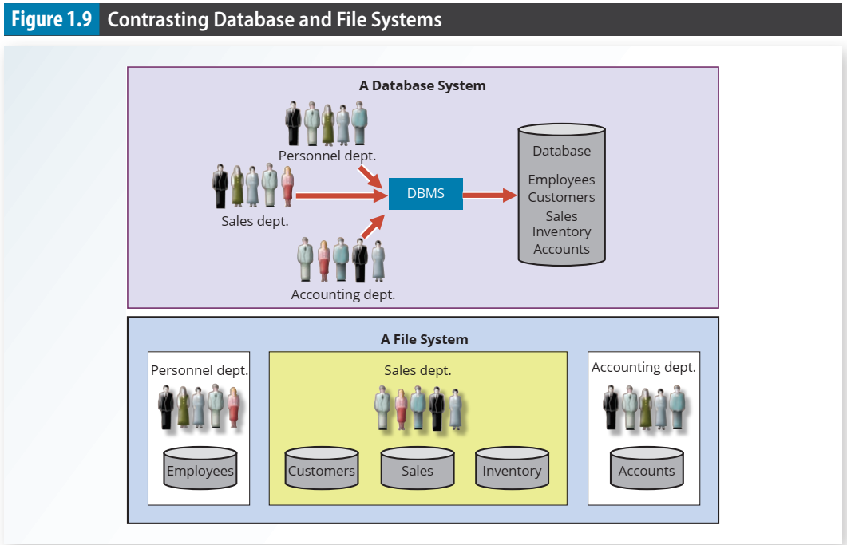
Database System Design, Implementation And Management

Slide 39
1-7a The Database System Environment
Database system: defines and regulates the collection, storage, management, use of data
Five major parts of a database system:
  Hardware
  Software
  People
  Procedures
  Data
Database System Design, Implementation And Management

Slide 40
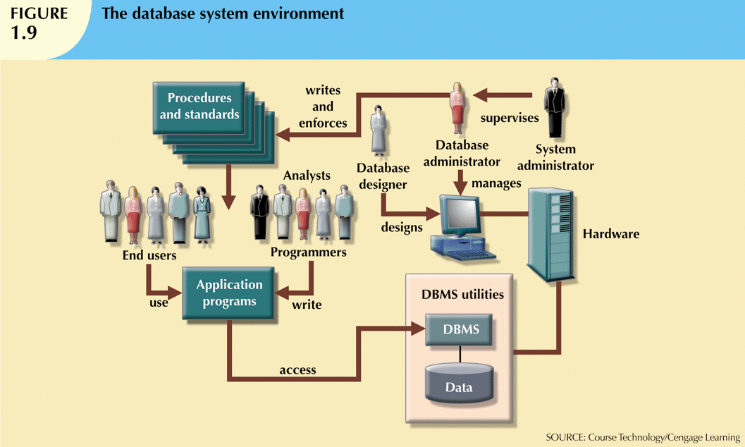
Database System Design, Implementation And Management

Slide 41
1-7a The Database System Environment (cont'd.)
Hardware: all the system’s physical devices
Software: three types of software required
  Operating system software
  DBMS software
  Application programs and utility software
Database System Design, Implementation And Management

Slide 42
1-7a The Database System Environment (cont'd.)
People: all users of the database system
  System and database administrators
  Database designers
  Systems analysts and programmers
  End users
Procedures: instructions and rules that govern the design and use of the database system
Data: the collection of facts stored in the database
Database System Design, Implementation And Management

Slide 43
1-7a The Database System Environment (cont'd.)
Database systems are created and managed at different levels of complexity
Database solutions must be cost-effective as well as tactically and strategically effective
Database technology already in use affects selection of a database system
Database System Design, Implementation And Management

Slide 44
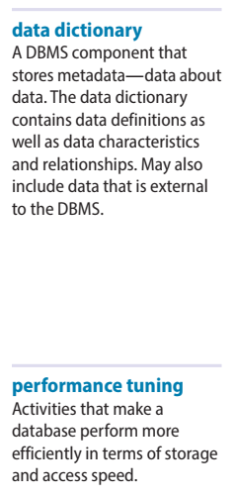
1-7b DBMS Functions
Most functions are transparent to end users
  Can only be achieved through the DBMS
Data dictionary management
  DBMS stores definitions of data elements and relationships (metadata) in a data dictionary
  DBMS looks up required data component structures and relationships
  Changes automatically recorded in the dictionary
  DBMS provides data abstraction and removes structural and data dependency
Database System Design, Implementation And Management

Slide 45
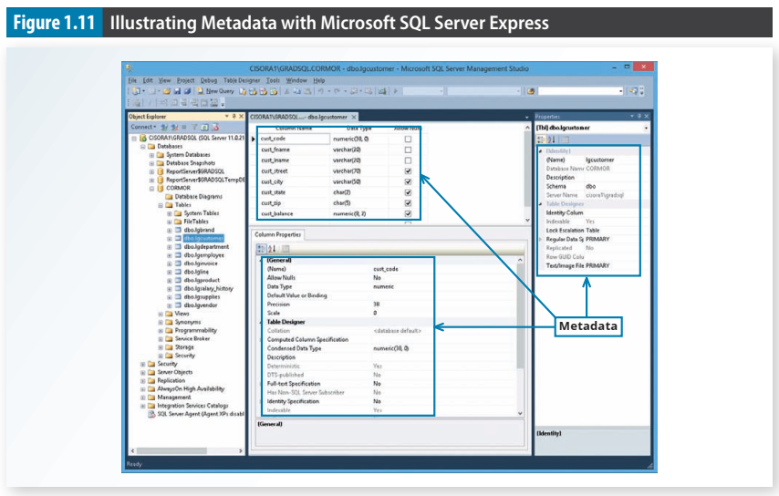
Database System Design, Implementation And Management

Slide 46
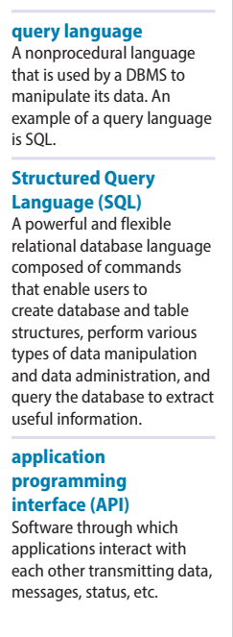
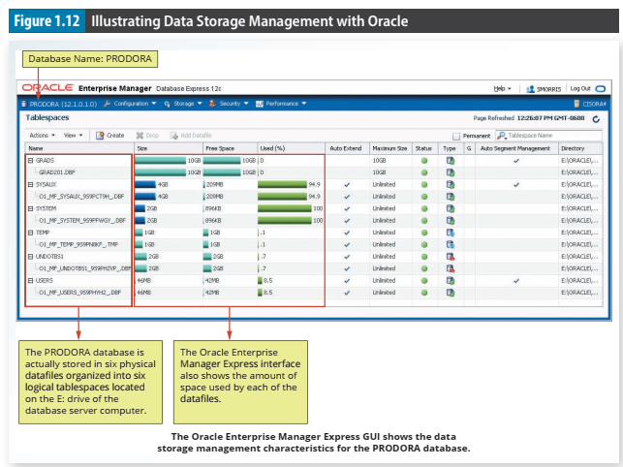
Database System Design, Implementation And Management

Slide 47
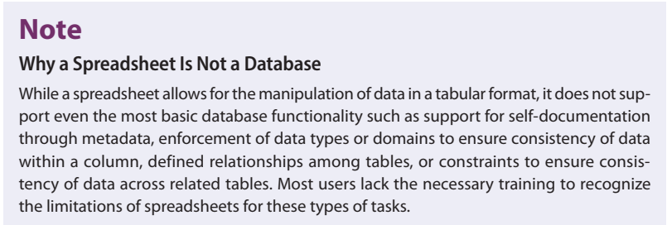
1-7b DBMS Functions (cont’d)
Data storage management
  DBMS creates and manages complex structures required for data storage
  Also stores related data entry forms, screen definitions, report definitions, etc.
  Performance tuning: activities that make the database perform more efficiently
  DBMS stores the database in multiple physical data files
Database System Design, Implementation And Management

Slide 48
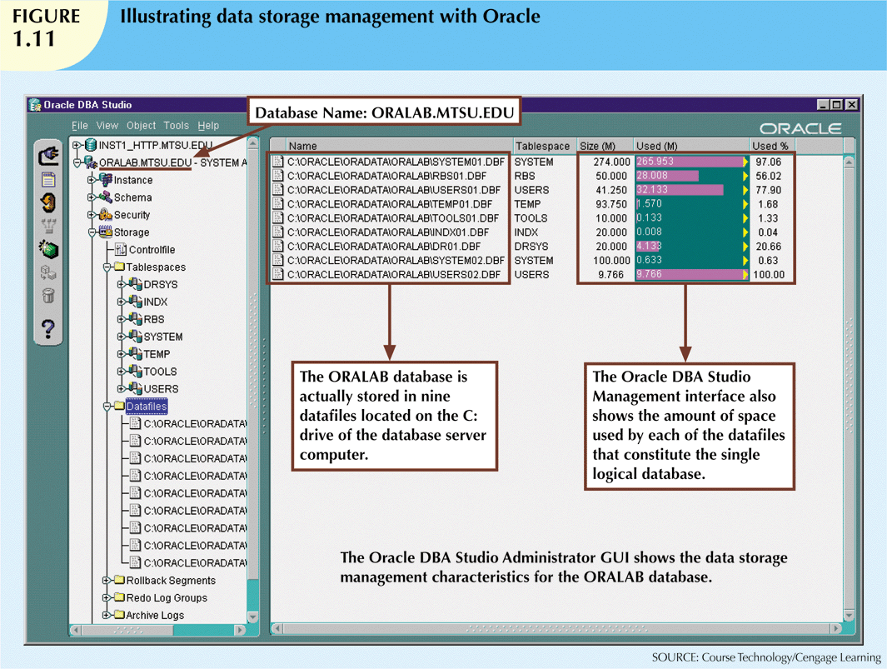
Database System Design, Implementation And Management

Slide 49
DBMS Functions (cont'd.)
Data transformation and presentation
  DBMS transforms data entered to conform to required data structures
  DBMS transforms physically retrieved data to conform to user’s logical expectations
Security management
  DBMS creates a security system that enforces user security and data privacy
  Security rules determine which users can access the database, which items can be accessed, etc.
Database System Design, Implementation And Management

Slide 50
DBMS Functions (cont'd.)
Multiuser access control
  DBMS uses sophisticated algorithms to ensure concurrent access does not affect integrity
Backup and recovery management
  DBMS provides backup and data recovery to ensure data safety and integrity
  Recovery management deals with recovery of database after a failure
    Critical to preserving database’s integrity
Database System Design, Implementation And Management

Slide 51
DBMS Functions (cont'd.)
Data integrity management
  DBMS promotes and enforces integrity rules
    Minimizes redundancy
    Maximizes consistency
  Data relationships stored in data dictionary used to enforce data integrity
  Integrity is especially important in transaction-oriented database systems
Database System Design, Implementation And Management

Slide 52
DBMS Functions (cont'd.)
Database access languages and application programming interfaces
  DBMS provides access through a query language
  Query language is a nonprocedural language
  Structured Query Language (SQL) is the de facto query language
    Standard supported by majority of DBMS vendors
Database System Design, Implementation And Management

Slide 53
DBMS Functions (cont'd.)
Database communication interfaces
  Current DBMSs accept end-user requests via multiple different network environments
  Communications accomplished in several ways:
    End users generate answers to queries by filling in screen forms through Web browser
    DBMS automatically publishes predefined reports on a Web site
    DBMS connects to third-party systems to distribute information via e-mail
Database System Design, Implementation And Management

Slide 54
1-7c Managing the Database System: A Shift in Focus
Database system provides a framework in which strict procedures and standards enforced
  Role of human changes from programming to managing organization’s resources
Database system enables more sophisticated use of the data
Data structures created within the database and their relationships determine effectiveness
Database System Design, Implementation And Management

Slide 55
1-7c Managing the Database System: A Shift in Focus (cont'd.)
Disadvantages of database systems:
  Increased costs
  Management complexity
  Maintaining currency
  Vendor dependence
  Frequent upgrade/replacement cycles
Database System Design, Implementation And Management

Slide 56
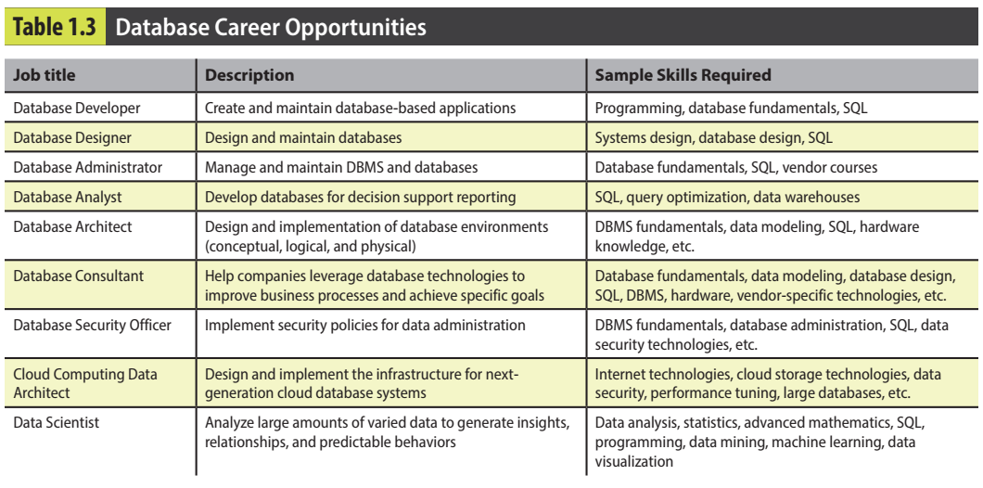
Preparing for Your Database Professional Career
Database System Design, Implementation And Management

Slide 57
Summary
Data are raw facts
Information is the result of processing data to reveal its meaning
Accurate, relevant, and timely information is the key to good decision making
Data are usually stored in a database
DBMS implements a database and manages its contents
Database System Design, Implementation And Management

Slide 58
Summary (cont'd.)
Metadata is data about data
Database design defines the database structure
  Well-designed database facilitates data management and generates valuable information
  Poorly designed database leads to bad decision making and organizational failure
Databases evolved from manual and computerized file systems
Database System Design, Implementation And Management

Slide 59
Summary (cont'd.)
In a file system, data stored in independent files
  Each requires its own management program
Some limitations of file system data management:
  Requires extensive programming
  System administration is complex and difficult
  Changing existing structures is difficult
  Security features are likely inadequate
  Independent files tend to contain redundant data
    Structural and data dependency problems
Database System Design, Implementation And Management

Slide 60
Summary (cont'd.)
Database management systems were developed to address file system’s inherent weaknesses
DBMS present database to end user as single repository
  Promotes data sharing
  Eliminates islands of information
DBMS enforces data integrity, eliminates redundancy, and promotes security
Database System Design, Implementation And Management

Slide 61
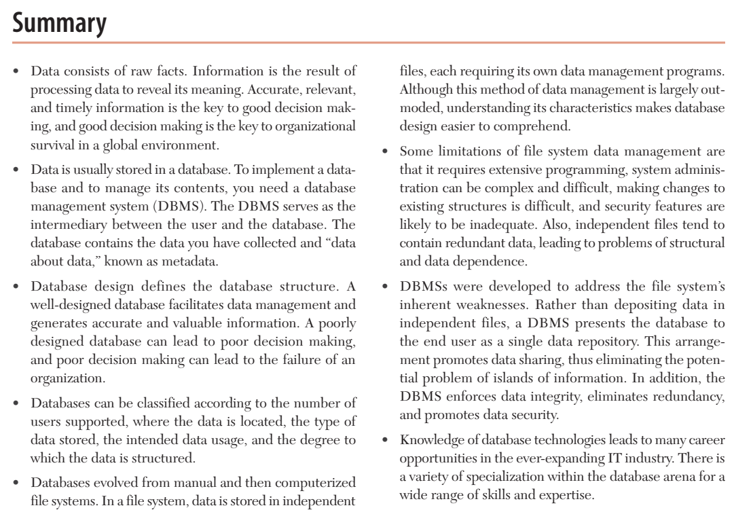
Database System Design, Implementation And Management

Slide 62
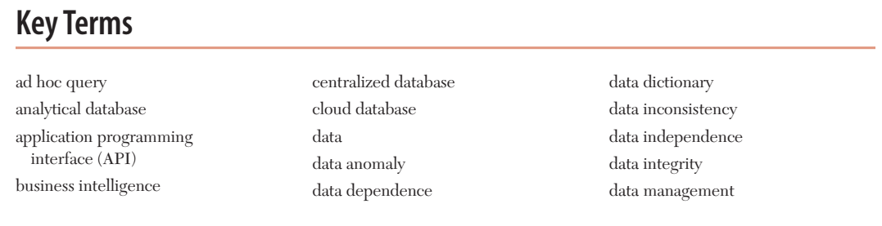
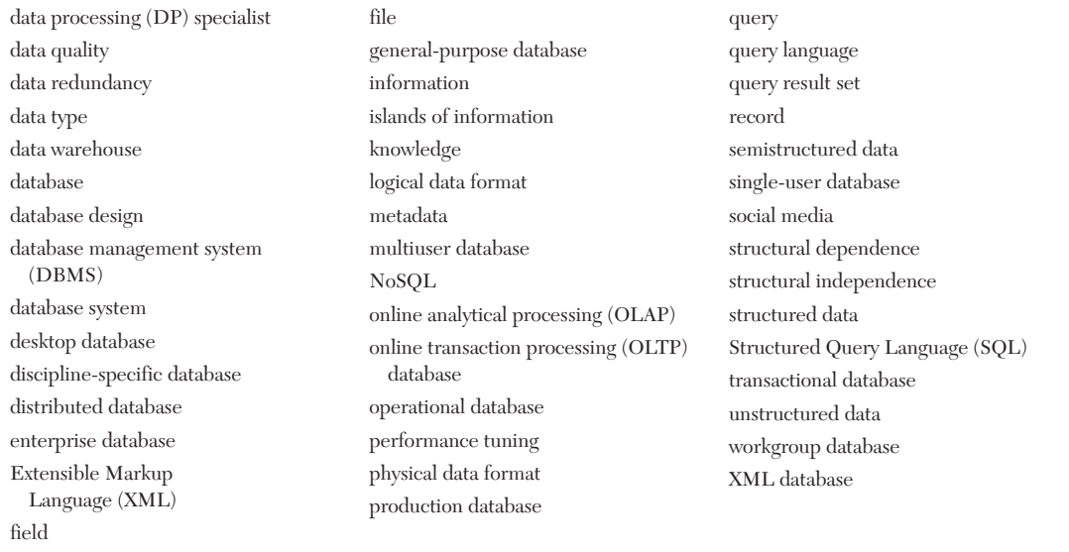
Database System Design, Implementation And Management

Slide 63
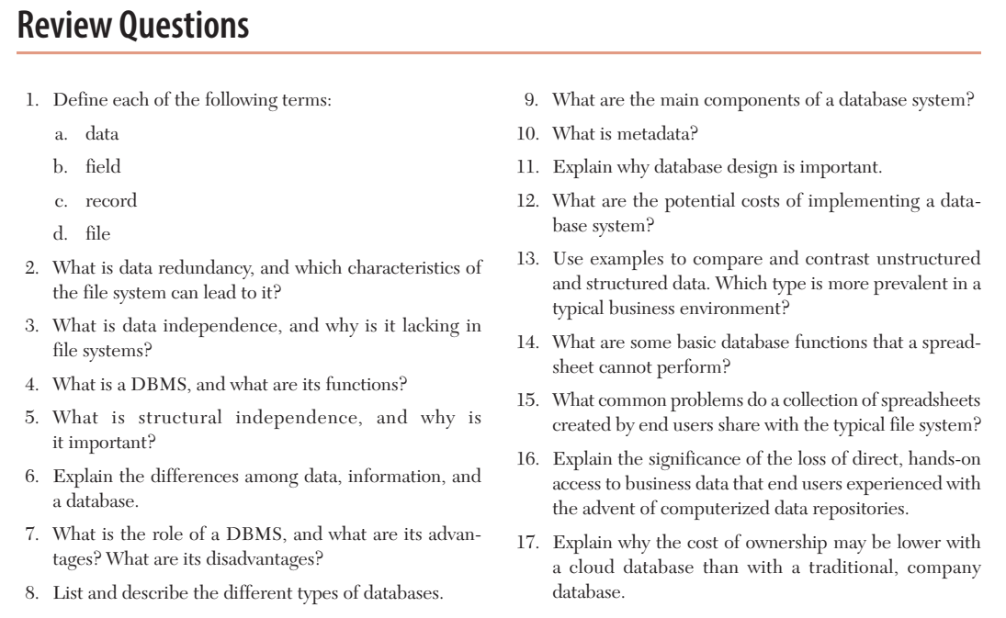
Database System Design, Implementation And Management

